Slide 1

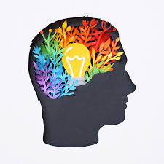
Peace & MinD
Created by :
Tyler Silverman, Caitlin Crews, Denny, Sim Kaur
Notes:
sim

Slide 2
What’s IS ‘PEACE & MIND’ ABOUT?
This app was created keeping ‘Brain’ in mind.
It will allow the user to play a mind game to exercise their brain.
In Addition, we wanted to let user have the option to meditate which will help the user relax their mind, calm down and perform better.
Notes:
Sim

Slide 3

Task Accomplished
Using our App, the user will be able to >>
Play a mind game.
Watch a Meditation video.
Motivation for development: As a team, We really liked the idea of creating a mind game app which will include a series of mind games (similar to luminosity ) as well as meditation video to relax the mind.
Notes:
dennis

Slide 4
Technologies used:
Html, css ( Bootstrap), JavaScript, Template Engine, Axios call.
Packages – Node, Express.
Tasks and roles :
We created this App as a Team doing Frontend and Backend all together ( Full Stack).
Challenges & successes:
We had some difficulty finding a perfect API for mind games
Functionality - Linking the login, dashboard, authentication, axios.
Notes:
tyler

Slide 5
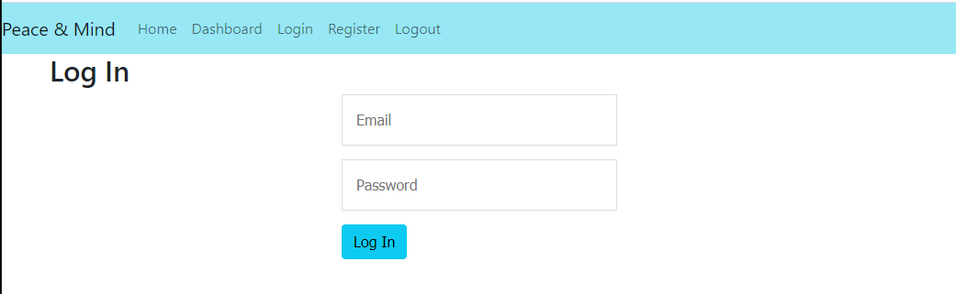
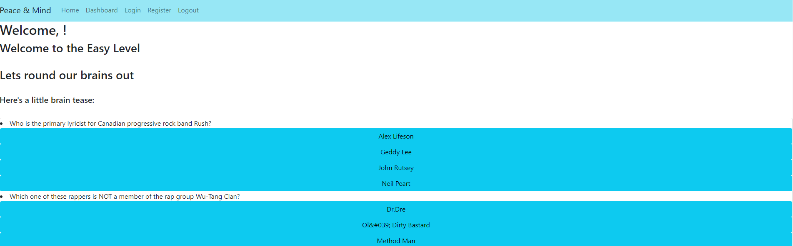
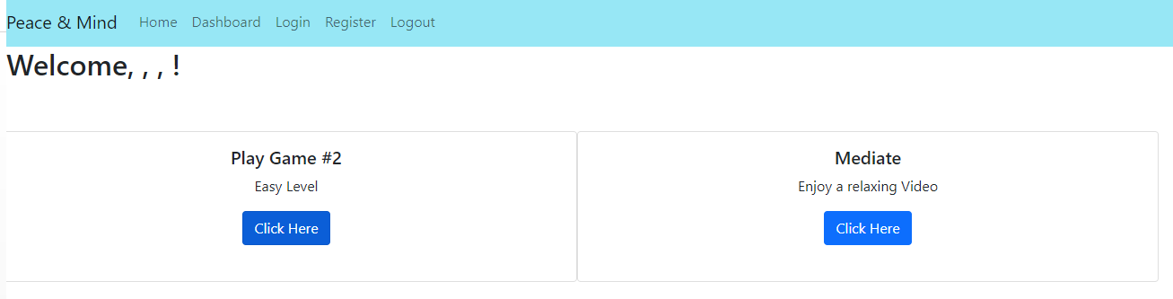
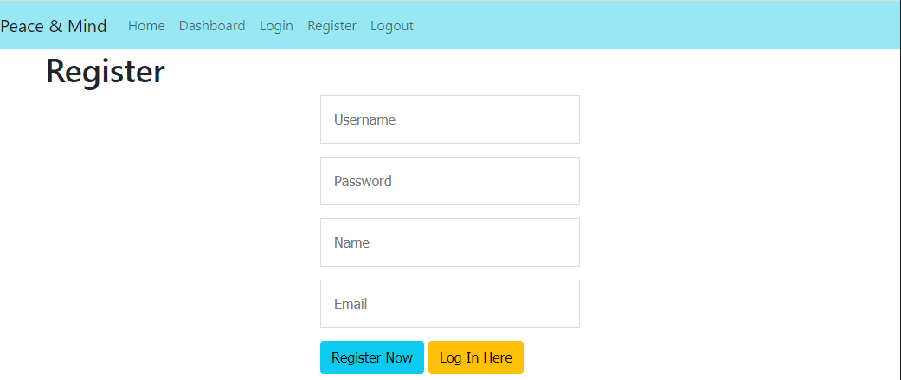
demo
Link :
Notes:
Caitlin

Slide 6
Future Development /icebox
We would like to >>
Add a series of different mind games to challenge different parts of the brain.
Various meditation videos.
a randomly generated meditation quote for the dashboard page.
Links to the article about benefits of meditation.
Notes:
Team

Slide 7
links
Deployed :
GitHub : https://github.com/simk2020/Project2.git
The END

